Slide 1
S2-19_DSECLZC415 UNSTRUCTURED DATA/ BIG DATA SESSION 13
AUGUST 8 2020 – Dr.D.VENKATA SUBRAMANIAN
Slide Courtesy: Prof. T.V. Rao

Slide 2
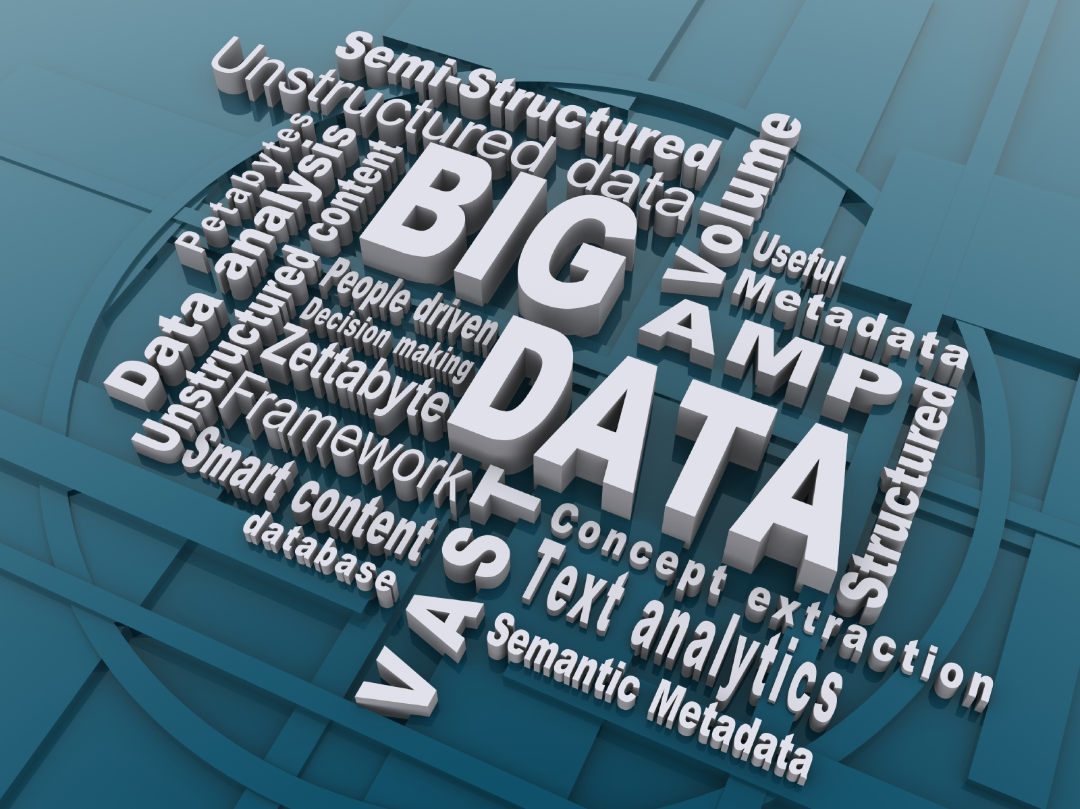
Big Data is the latest …

Slide 3


A quick technical tour on Big Data & Hadoop
By
Dr.D.Venkata Subramanian

Slide 4












Big Data is a Hot Topic Because Technology Makes it Possible to Analyze ALL Available Data
Cost effectively manage and analyze all available data in its native form
unstructured, structured, streaming
Website
Social Media
Billing
ERP
CRM
RFID
Network Switches
Notes:
4
When we start to discuss this topic with our customers we have a very interesting feedback. First of all they all think this is just a buzzword all the people are talking about and nobody already has seen something what is doing something reasonable. Then they have a feeling that big data and hadoop are synonyms and moreover that hadoop is something what’s dedicated just to the processing of unstructured data – mainly text data. We will show you in next slides this is not the truth – at least from IBM’s point of view.
When we talk with our customers who lived many years surrounded by traditional systems they have expectation big data is or will be something very similar to what they know, but this is not true as well. If we have time to discuss the area deeper (and we don’t have it) you would see this is something very different and what requires a little bit changes in the way of human thinking. A lot of concepts that are needed for traditional systems run are not there at all and this is often something suspicious. So, be prepared during the future much deeper discussions with vendors you will hear something what will surprise you and what will need some mental switch.
-------------------------------------
Another reason that big data is a hot topic in the market today is the new technology that enables an organization to take advantage of the natural resource of big data. Big data itself isn’t new – its been here for a while and growing exponentially. What is new is the technology to process and analyze it. The purpose of big data technology is to cost effectively manage and analyze all of the available data. Any data, as is. If you want to analyze structured data, then structure it. If you want to analyze an acoustic file, then analyze the acoustic file with appropriate analytics.
You’ll see the wide variety of sources of big data. It comes from our traditional systems – Billing systems, ERP systems, CRM systems. It also comes from machine data – from RFID tags, sensors, network switches. And it comes from humans – website data, social media, etc.

Slide 5
Type of Data
Relational Data (Tables/Transaction/Legacy Data)
Text Data (Web)
Semi-structured Data (XML)
Graph Data
Social Network, Semantic Web (RDF), …
Streaming Data
You can only scan the data once

Slide 6
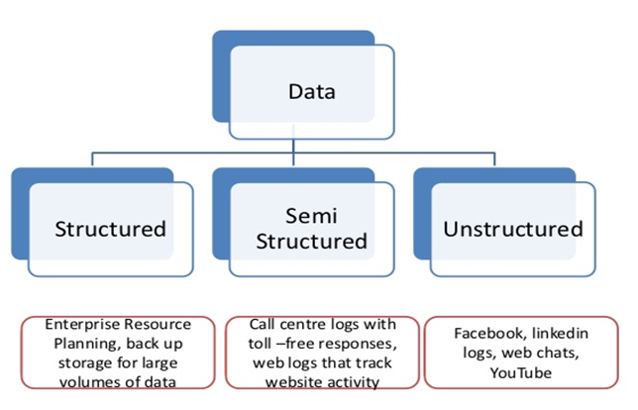

Types of Data
Examples of semi-structured : CSV but XML and JSON documents are semi structured documents, NoSQL databases are considered as semi structured.
Structured Data usually organized in to columns and rows.
Examples of Unstructured Data. Unstructured datafiles often include text and multimedia content. Examples include e-mail messages, word processing documents, videos, photos, audio files, presentations, webpages and many other kinds of business documents.

Slide 7


Two Universes Are the New Reality
Structured
&
Unstructured
Relational DB Systems
NoSQL Systems
Structured data w/ known schema
(Un)(Semi)structured data w/o schema
ACID
No ACID
Transactions
No transactions
SQL
No SQL
Rigid Consistency Model
Eventual consistency
ETL
No ETL
Longer time to insight
Faster time to insight
Maturity, stability, efficiency
Flexibility

Slide 8




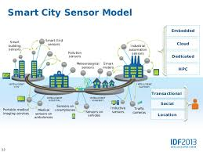

Sources of Data

Slide 9
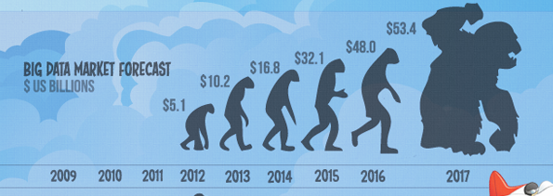
Contd..
Walmart handles more than 1 million customer transactions every hour.
• Facebook handles 40 billion photos from its user base.
• Decoding the human genome originally took 10years to process; now it can be achieved in one week.

Slide 10
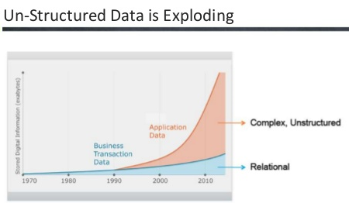
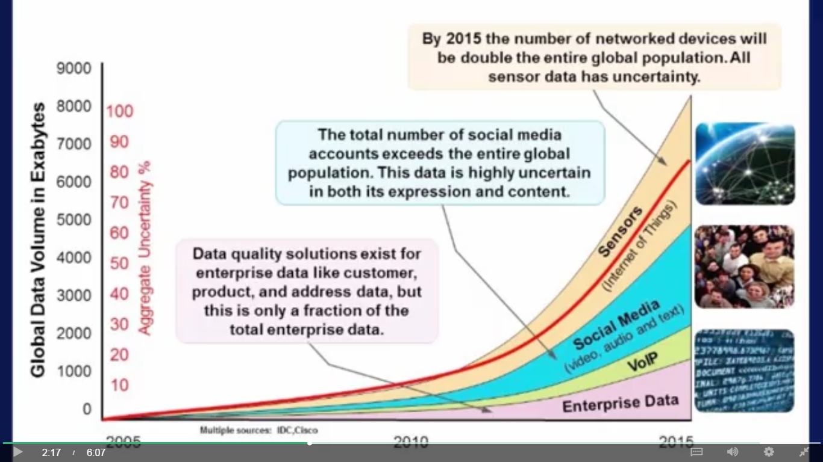
Contd..
Data Exploration

Slide 11
What to do with these data?
Aggregation and Statistics
Data warehouse and OLAP
Indexing, Searching, and Querying
Keyword based search
Pattern matching (XML/RDF)
Knowledge discovery
Data Mining
Statistical Modeling

Slide 12
3Vs->4Vs->5Vs->6Vs->… now recently 7Vs
Volume -> The ability to ingest, process and store very large datasets.
Velocity: Speed of data generation and frequency of delivery.
Variety: It refers to data from different sources and types which may be structured or unstructured.
Variability: This refers to establishing if the contextualizing structure of the data stream is regular/dependable even in conditions of extreme unpredictability. Example: 6 Coffee blends…
Veracity is all about making sure the data is accurate, which requires processes to keep the bad data from accumulating in your systems. The simplest example is contacts that enter your marketing automation system with false names and inaccurate contact information.
Visualization is critical in today’s world. Using charts and graphs to visualize large amounts of complex data is much more effective in conveying meaning than spreadsheets and reports chock-full of numbers and formulas.
Value: After addressing volume, velocity, variety, variability, veracity, and visualization – which takes a lot of time, effort and resources – you want to be sure your organization is getting value from the data.

Slide 13
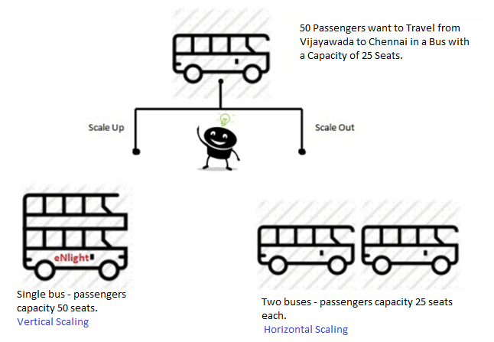
Challenges in Big Data
Capture
Storage
Searching
Sharing
Transfer
Scalability
Analysis
Present

Slide 14
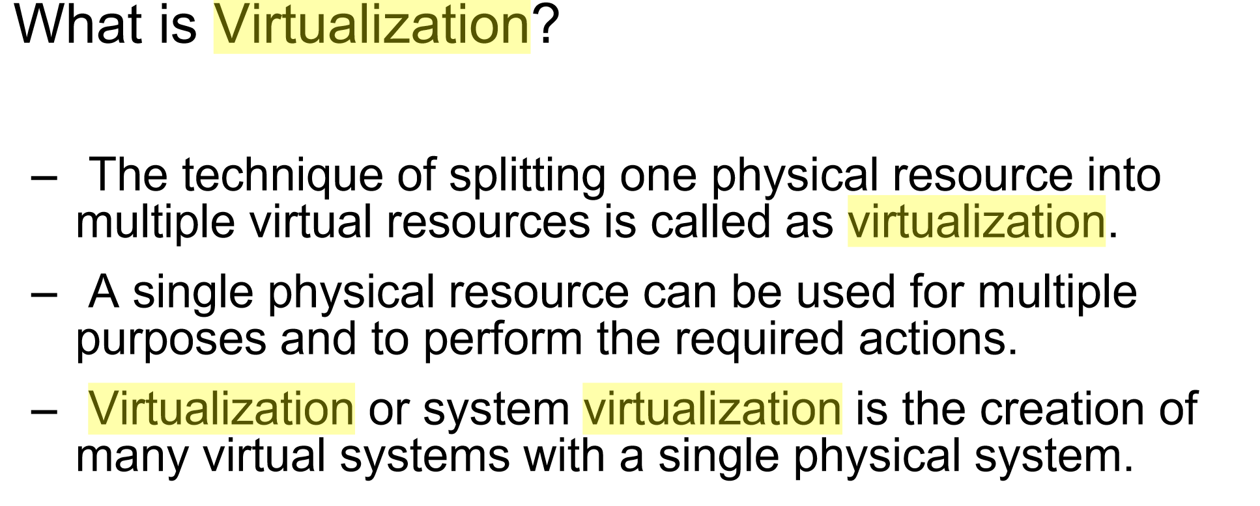
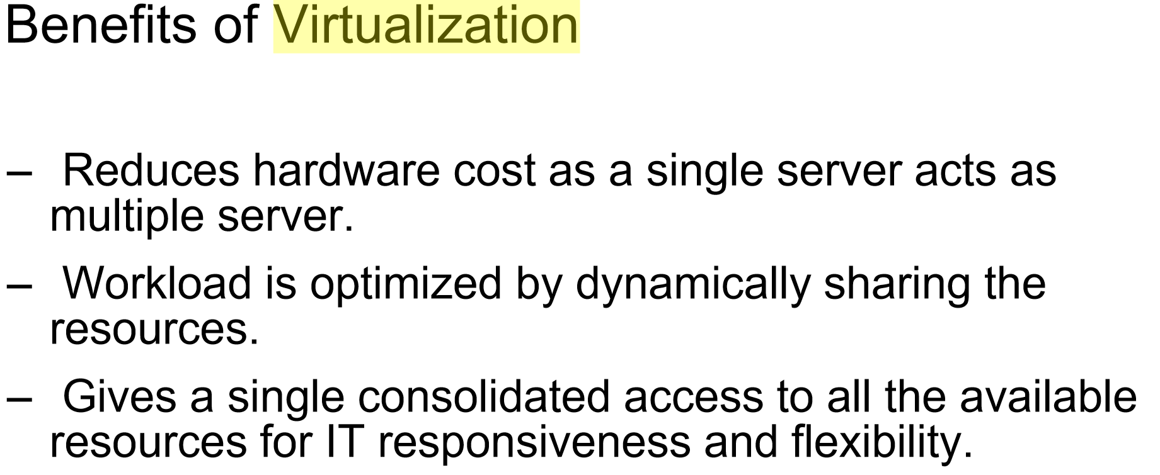

Slide 15
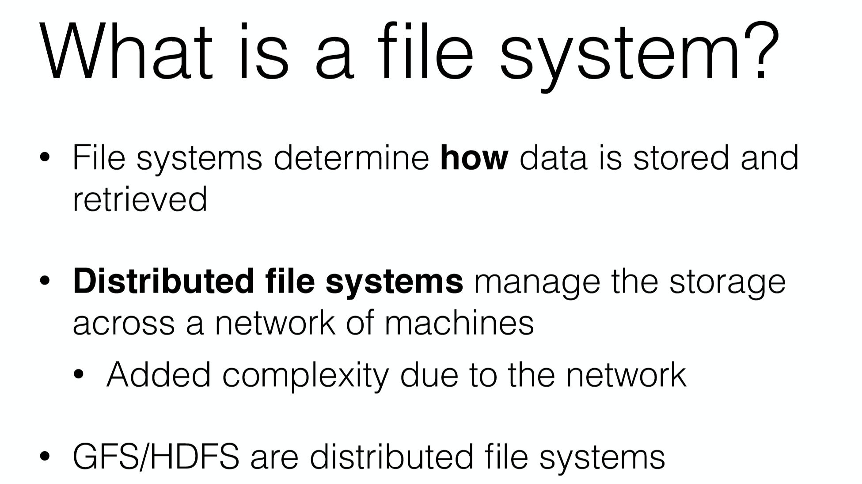

Slide 16
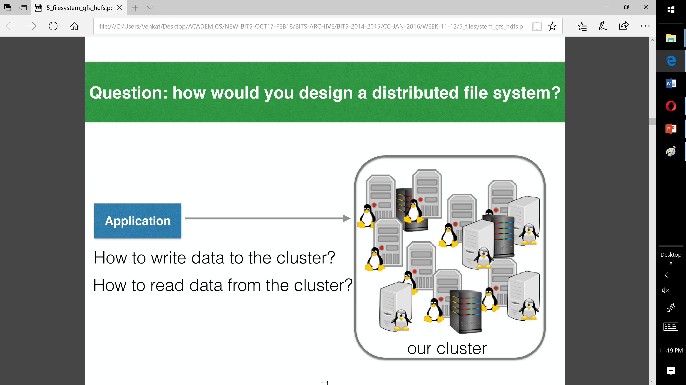

Slide 17
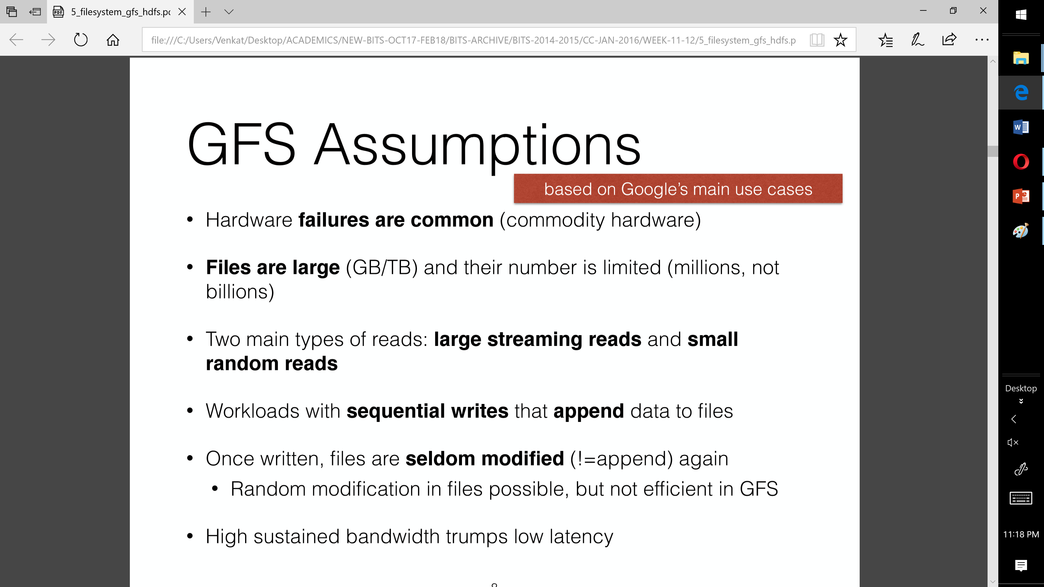

Slide 18
Hadoop introduction
Apache Hadoop is a framework that allows for the distributed processing of large data sets across clusters of commodity computers using a simple programming model.
It is an Open-source Data Management with scale-out storage & distributed processing.

Slide 19
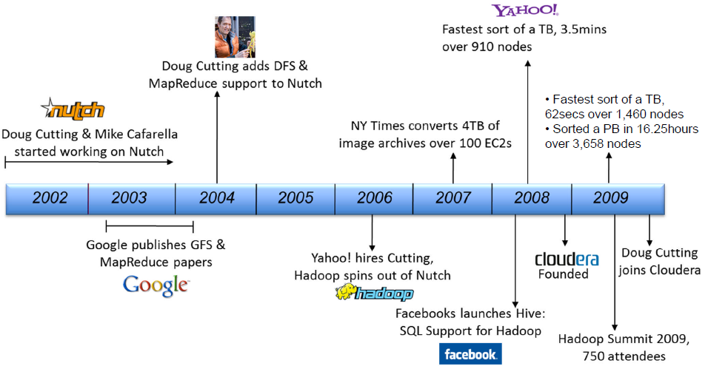
Hadoop History

Slide 20
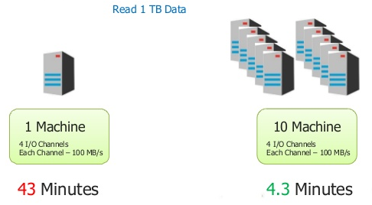
Why Hadoop?

Slide 21
Characteristics of Hadoop
Reliable
Hadoop Framework is reliable as it maintain fault tolerant nodes.
Scalable
Scale out / Horizontal Scaling permits to add any number of nodes.
Flexible
Anytime administrators can add or remove nodes without interrupt in services.
Economical
Hadoop use commodity hardware.

Slide 22
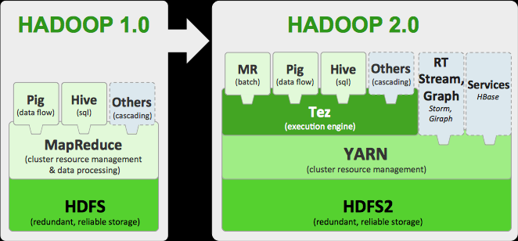
Hadoop Architecture

Slide 23
Other Tools
Contd..
Hive
Hadoop processing with SQL
Pig
Hadoop processing with scripting
Spark
Stream Processing in HDFS
HBase
Database model built on top of Hadoop
A scalable, distributed database that supports structured data storage for large tables.
Flume
Designed for large scale data movement
Mahout:
A Scalable machine learning and data mining library.

Slide 24
Hadoop Core Components
Hadoop Common
Contains Libraries and other modules
HDFS
Hadoop Distributed File System
Hadoop YARN
Yet Another Resource Negotiator
Hadoop MapReduce
A programming model for large scale data processing

Slide 25
HDFS Basic Concept
HDFS is a file system written in Java based on the Google’s GFS
Provides redundant storage for massive amounts of data

Slide 26
HDFS Basic Concept
HDFS works best with a smaller number of large files
Millions as opposed to billions of files
Typically 100MB or more per file
Files in HDFS are write once
Optimized for streaming reads of large files and not random reads

Slide 27
How Files are stored
Files are split into blocks
Blocks are split across many machines at load time
Different blocks from the same file will be stored on different machines
Blocks are replicated across multiple machines
The NameNode keeps track of which blocks make up a file and where they are stored
Notes:
Default replication is 3-fold

Slide 28
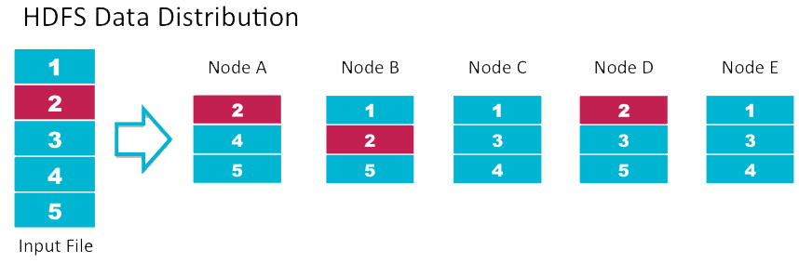
Data Replication
Data Replication
Default replication is 3-fold

Slide 29
Data Retrival
When a client wants to retrieve data
Communicates with the NameNode to determine which blocks make up a file and on which data nodes those blocks are stored
Then communicated directly with the data nodes to read the data

Slide 30
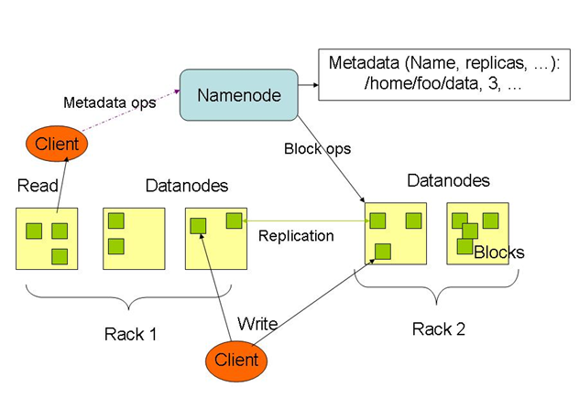
HDFS Architecture

Slide 31
What is MapReduce ?
MapReduce is a programming model
It is neither platform- nor language-specific
Record-oriented data processing (key and value)
Task distributed across multiple nodes
Where possible, each node processes data stored on that node
Consists of two phases
Map
Reduce
Key
Value
MapReduce

Slide 32
MapReduce Features
Phases
Input Phase:
Record reader helps to read each record of input file and send it to mapper in the form of key-value pairs.
Map Phase:
It’s a user defined function which takes a series of key value pairs and process each of them to generate zero or more number of key-value pairs.
Combiner Phase:
It takes map output and aggregate these key-value pairs.

Slide 33
MapReduce Features
Contd..
Shuffle & Sort Phase:
The reducer task start with this phase. The aggregated output of the combiner is downloaded into the local machine where reducer is running. These key-value pairs are stored into large data set by key.
Reducer Phase:
The output of shuffle & sort phase is given to reducer phase. It may perform one of these Aggregation, Filtering and Combine operations.
Output Phase:
Record writer helps to store the output of reducer phase onto HDFS.

Slide 34
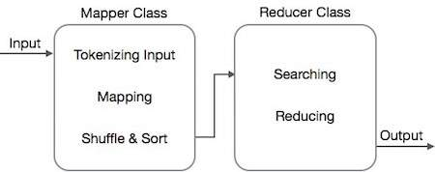
How MapReduce works..

Slide 35
MapReduce API
MapReduce programming focus on
JobContext Interface
JobContext interface is the super interface for all the classes which perform MR jobs.
Job Class.
It allows the user to configure the job, submit it, control its execution, and query the state.
Mapper Class
Maps input key-value pairs to a set of intermediate key-value pairs.
Reducer Class
Reducer implementations can access the Configuration for a job via the JobContext.getConfiguration() method.

Slide 36
Contd..
Partitioner
A partitioner partitions the key-value pairs of intermediate Map-outputs. It partitions the data using a user-defined condition, which works like a hash function. The total number of partitions is same as the number of Reducer tasks for the job. Let us take an example to understand how the partitioned works.
Combiner
The Combiner class is used in between the Map class and the Reduce class to reduce the volume of data transfer between Map and Reduce. Usually, the output of the map task is large and the data transferred to the reduce task is high.

Slide 37
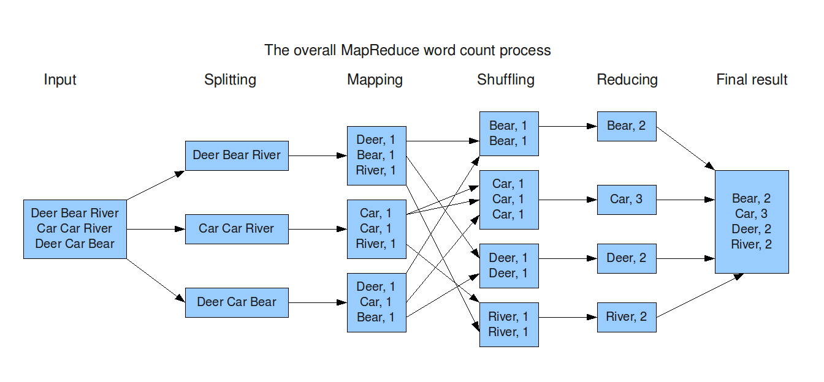
Contd..

Slide 38
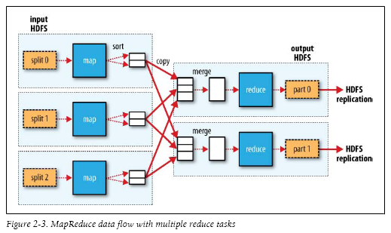
MapReduce Data Flow

Slide 39
TEXT MINING

Slide 40

Mining Text Data: An Introduction
Data Mining / Knowledge Discovery
Structured Data Multimedia Free Text Hypertext
HomeLoan (
Loanee: Frank Rizzo
Lender: MWF
Agency: Lake View
Amount: $200,000
Term: 15 years
)
Frank Rizzo bought
his home from Lake
View Real Estate in
1992.
He paid $200,000
under a15-year loan
from MW Financial.
<a href>Frank Rizzo
</a> Bought
<a hef>this home</a>
from <a href>Lake
View Real Estate</a>
In <b>1992</b>.
<p>...
Loans($200K,[map],...)
Notes:
Throughout this course we have been discussing Data Mining over a variety of data types.
Two former types we covered were Structured Data (relational) and multimedia data.
Today and in the last class we have been discussing Data Mining over free text,
and our next section will cover hypertext, such as web pages.
Text mining is well motivated, due to the fact that much of the world’s data can be
found in free text form (newspaper articles, emails, literature, etc.). There is a
lot of information available to mine.
While mining free text has the same goals as data mining in general
(extracting useful knowledge/stats/trends), text mining must overcome
a major difficulty – there is no explicit structure.
Machines can reason will relational data well since schemas are explicitly available.
Free text, however, encodes all semantic information within natural language. Our
text mining algorithms, then, must make some sense out of this natural language
representation. Humans are great at doing this, but this has proved to be a problem for machines.

Slide 41
Bag-of-Tokens Approaches
Documents
Token Sets
Four score and seven years ago our fathers brought forth on this continent, a new nation, conceived in Liberty, and dedicated to the proposition that all men are created equal.
Now we are engaged in a great civil war, testing whether that nation, or …
nation – 5
civil - 1
war – 2
men – 2
died – 4
people – 5
Liberty – 1
God – 1
…
Feature
Extraction
Loses all order-specific information!
Severely limits context!
Notes:
The previous text mining presentations “made sense” out of free text by
viewing text as a bag-of-tokens (words, n-grams). This is the same approach as IR.
Under that model we can already summarize, classify, cluster, and compute co-occurrence stats over free text.
These are quite useful for mining and managing large volumes of free text.
However, there is a potential to do much more. The BOT approach loses a LOT of information
contained in text, such as word order, sentence structure, and context. These are precisely the
features that humans use to interpret text.
Thus the natural question is can we do better?

Slide 42
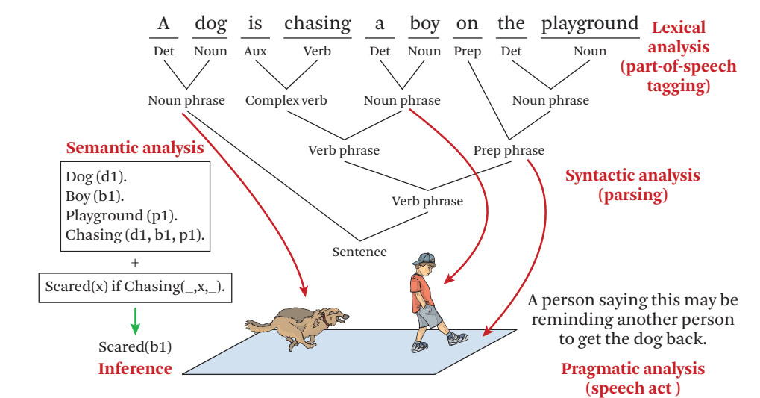
Natural Language Processing
Text Data Management and Analysis: A Practical Introduction to Information Retrieval and Text Mining ChengXiang Zhai, Sean Massung, ACM Books 2016
Notes:
NLP, or Computational Linguistics, is an entire field dedicated to the study
of automatically understanding free text. This field has been active since the 50’s.
General NLP attempts to understand document completely (at the level of a human reader).
There are several steps involved in NLP.
…Blah…

Slide 43
How to Understand Text Data
Lexical analysis. Figure out what the basic meaningful units in a language are (e.g., words in English) and determine the meaning of each word
Syntactic analysis. Determine how words are related with each other in a sentence, thus revealing the syntactic structure of a sentence.
Semantic analysis. Determine the meaning of a sentence. Find meaning of a whole sentence or a larger unit based on the meanings of words and the syntactic structure.
Pragmatic analysis. Determine meaning in context, a deeper understanding of natural language than semantic analysis is thus to further understand the purpose in communication
Discourse analysis. Needed when a large chunk of text with multiple sentences is to be analyzed; in such a case, the connections between these sentences must be considered and the analysis of an individual sentence must be placed in the appropriate context involving other sentences.

Slide 44
General NLP—Too Difficult!
Word-level ambiguity
“design” can be a noun or a verb (Ambiguous POS)
“root” has multiple meanings (Ambiguous sense)
Syntactic ambiguity
“natural language processing” (Modification)
“A man saw a boy with a telescope.” (PP Attachment)
Anaphora resolution
“John persuaded Bill to buy a TV for himself.”
(himself = John or Bill?)
Presupposition
“He has quit smoking.” implies that he smoked before.
Humans rely on context to interpret (when possible).
This context may extend beyond a given document!
Notes:
General NLP has proven to be too difficult. It is dubbed “AI-Complete”, meaning that such a
program would basically have to have near-human intelligence (i.e. solve AI).
The reason NLP in general is so difficult is that text is highly ambiguous. NL is meant for
human consumption and often contains ambiguities under the assumption that humans
will be able to develop context and interpret the intended meaning.
For instance [rewind], in this example the sentence could mean that either the dog, or the boy, or both
are on the playground. As a human we know that it is probably both, but that is due to our
knowledge that a dog is probably chasing close behind the boy, playgrounds are large,
they are probably playing, and a playground is a place to play. This background knowledge
probably is not contained in a document containing this sentence.
Despite such obstacles, computational linguists have made great progress on several subproblems.
We will now talk about four of these subproblems.

Slide 45
Shallow Linguistics
Progress on Useful Sub-Goals:
English Lexicon
Part-of-Speech Tagging
Word Sense Disambiguation
Phrase Detection / Parsing
Notes:
Several subgoals to NLP have been addressed to derive more info than just bag-of-tokens view.
English lexicon, POS Tagging, WSD, Parsing
Even with imperfect performance, these solutions already open the door for more intelligent text processing.

Slide 46
WordNet
An extensive lexical network for the English language
a large lexical database of English. Nouns, verbs, adjectives and adverbs grouped into sets of cognitive synonyms expressing a distinct concept, hosted at wordnet.princeton.edu, seems inactive now
Contains over 138,838 words.
Several graphs, one for each part-of-speech.
Synsets (synonym sets), each defining a semantic sense.
Relationship information (antonym, hyponym, meronym …)
Downloadable for free (UNIX, Windows)
Expanding to other languages (Global WordNet Association)
Funded >$3 million, mainly government (translation interest)
Founder George Miller, National Medal of Science, 1991.
watery
parched
moist
wet
dry
arid
synonym
antonym
damp
anhydrous
Notes:
WordNet is an extensive lexical network for the human language.
Consists of a graph of synsets for each part of speech. Contains synonym and antonym relationships.
(hyponym=isa/subset, maple is a tree -> maple is a hyponym of tree)
(meronym=hasa, tree has a leaf -> leaf is a meronym of tree)
As will see, this is useful throughout NLP/ShallowLinguistics.
This encodes some of the lexicon that humans carry with them when interpreting text.

Slide 47
Word Sense Disambiguation
“The difficulties of computational linguistics are rooted in ambiguity.”
N Aux V P N
Supervised Learning
Features:
Neighboring POS tags (N Aux V P N)
Neighboring words (linguistics are rooted in ambiguity)
Stemmed form (root)
Dictionary/Thesaurus entries of neighboring words
High co-occurrence words (plant, tree, origin,…)
Other senses of word within discourse
Algorithms:
Rule-based Learning
Statistical Learning (i.e. Naïve Bayes)
Unsupervised Learning (i.e. Nearest Neighbor)
Notes:
WSD attempts to resolve ambiguity by labeling each word with a precise sense, as intended in the document.
This is typically performed after POS tagging, since POS tags are quite useful for WSD.
Current approaches address this as a supervised learning problem.
Features include neighboring words w/ POS tags, stemmed form of word, high co-occurrence words (with stem).
Quite a few supervised learning algorithms have been applied (rule-lists, bayesian, NN).
Performance depends heavily upon the particular text, but from what I’ve read 90%+ accuracy is common.

Slide 48
Parsing
Choose most likely parse tree…
S
Probability of this tree=0.000015
Probabilistic CFG
NP
VP
S→ NP VP
NP → Det BNP
NP → BNP
NP→ NP PP
BNP→ N
VP → V
VP → Aux V NP
VP → VP PP
PP → P NP
V → chasing
Aux→ is
N → dog
N → boy
N→ playground
Det→ the
Det→ a
P → on
1.0
0.3
0.4
0.3
Det
BNP
VP
PP
A
N
Aux
V
NP
P
NP
Grammar
…
dog
is
chasing
on
a boy
…
.
the playground
.
.
1.0
S
Probability of this tree=0.000011
NP
VP
0.01
Det
NP
BNP
Aux
V
0.003
PP
Lexicon
A
N
is
chasing
NP
P
NP
…
dog
a boy
on
…
the playground
Notes:
Parsing attempts to infer the precise grammatical relationships between different words in a given sentence.
For example, POS are grouped into phrases and phrases are combined into sentences.
Approaches include parsing with probabilistic CFG’s, “link dictionaries”, and tree adjoining techniques (super-tagging).
Current techniques can only parse at the sentence level, in some cases reporting accuracy in the 90% range.
Again, the performance heavily depends upon the grammatical correctness and the degree of ambiguity of the text.

Slide 49
Obstacles
Ambiguity
“A man saw a boy with a telescope.”
Computational Intensity
Imposes a context horizon.
Text Mining NLP Approach:
Locate promising fragments using fast IR methods (bag-of-tokens).
Only apply slow NLP techniques to promising fragments.
Notes:
The biggest obstacle to sophisticated NLP is ambiguity. Humans are quite skilled at inferring context and meaning.
NLP is expensive and can currently only be performed on the small scale (per-sentence, selective sentences).
This restriction further limits our ability to derive context (from across the document).
Current approach is to use fast IR techniques (bag-of-tokens) to determine promising text fragments and then apply more expensive NLP techniques on those fragments. (same idea is in multimedia mining)

Slide 50
Summary: Shallow NLP
However, shallow NLP techniques are feasible and useful:
Lexicon – machine understandable linguistic knowledge
possible senses, definitions, synonyms, antonyms, typeof, etc.
POS Tagging – limit ambiguity (word/POS), entity extraction
“...research interests include text mining as well as bioinformatics.”
WSD (word sense disambiguation) – stem/synonym/hyponym matches (doc and query)
Query: “Foreign cars” Document: “I’m selling a 1976 Jaguar…”
Parsing – logical view of information (inference?, translation?)
“A man saw a boy with a telescope.”
Even without complete NLP, any additional knowledge extracted from text data can only be beneficial.
Ingenuity will determine the applications.
Notes:
Even though general NLP is elusive, the subgoals presented here already provide opportunity for more intelligent text processing/analysis.
POS Tagging can provide a basis for extracting relations/facts (IE – HMM approach example).
WSD can resolve semantic ambiguities at the word-level. Even interpret synonyms as related. (laptop, notebook) (in document and query)
Parsing can translate free text into a logical, machine-understandable representation of the stated “knowledge”. (MT?, Inference?)
Rest is up to ingenuity, but it seems clear that as more of the knowledge encoded in text can be machine-understood we will be able to build systems to more intelligently work/reason with textual data.

Slide 51
Text Databases and IR
Text databases (document databases)
Large collections of documents from various sources: news articles, research papers, books, digital libraries, e-mail messages, and Web pages, library database, etc.
Data stored is usually semi-structured
Traditional information retrieval techniques become inadequate for the increasingly vast amounts of text data
Information retrieval
A field developed in parallel with database systems
Information is organized into (a large number of) documents
Information retrieval problem: locating relevant documents based on user input, such as keywords or example documents

Slide 52
Information Retrieval
Typical IR systems
Online library catalogs
Online document management systems
Information retrieval vs. database systems
Some DB problems are not present in IR, e.g., update, transaction management, complex objects
Some IR problems are not addressed well in DBMS, e.g., unstructured documents, approximate search using keywords and relevance

Slide 53
Basic Measures for Text Retrieval
Relevant
Relevant & Retrieved
Retrieved
All Documents
Precision: the percentage of retrieved documents that are in fact relevant to the query (i.e., “correct” responses)
Recall: the percentage of documents that are relevant to the query and were, in fact, retrieved

Slide 54
Information Retrieval Techniques
Basic Concepts
A document can be described by a set of representative keywords called index terms.
Different index terms have varying relevance when used to describe document contents.
This effect is captured through the assignment of numerical weights to each index term of a document. (e.g.: frequency, tf-idf)
DBMS Analogy
Index Terms → Attributes
Weights → Attribute Values

Slide 55
Information Retrieval Techniques
Index Terms (Attribute) Selection:
Stop list
Word stem
Index terms weighting methods
Terms  Documents Frequency Matrices
Information Retrieval Models:
Boolean Model (simplistic)
Vector Space Model (Document Ranking considered)
Etc.

Slide 56
Boolean Model
Consider that index terms are either present or absent in a document
As a result, the index term weights are assumed to be all binaries
A query is composed of index terms linked by three connectives: not, and, and or
e.g.: car and repair, plane or airplane
The Boolean model predicts that each document is either relevant or non-relevant based on the match of a document to the query

Slide 57
Keyword-Based Retrieval
A document is represented by a string, which can be identified by a set of keywords
Queries may use expressions of keywords
E.g., car and repair shop, tea or coffee, DBMS but not Oracle
Queries and retrieval should consider synonyms, e.g., repair and maintenance
Major difficulties of the model
Synonymy: A keyword T does not appear anywhere in the document, even though the document is closely related to T, e.g., data mining
Polysemy: The same keyword may mean different things in different contexts, e.g., mining

Slide 58
Similarity-Based Retrieval in Text Data
Finds similar documents based on a set of common keywords
Answer should be based on the degree of relevance based on the nearness of the keywords, relative frequency of the keywords, etc.
Basic techniques
Stop list
Set of words that are deemed “irrelevant”, even though they may appear frequently
E.g., a, the, of, for, to, with, etc.
Stop lists may vary when document set varies

Slide 59
Similarity-Based Retrieval in Text Data
Word stem
Several words are small syntactic variants of each other since they share a common word stem
E.g., drug, drugs, drugged
A term frequency table
Each entry frequent_table(i, j) = # of occurrences of the word t_{i} in document d_{i}
Usually, the ratio instead of the absolute number of occurrences is used
Similarity metrics: measure the closeness of a document to a query (a set of keywords)
Relative term occurrences
Cosine distance:

Slide 60
Vector Space Model
Represent a doc by a term vector
Term: basic concept, e.g., word or phrase
Each term defines one dimension
N terms define a N-dimensional space
Element of vector corresponds to term weight
E.g., d = (x₁,…,x_{N}), x_{i} is “importance” of term i
New document is assigned to the most likely category based on vector similarity.

Slide 61
What VS Model Does Not Specify
How to select terms to capture “basic concepts”
Word stopping
e.g. “a”, “the”, “always”, “along”
Word stemming
e.g. “computer”, “computing”, “computerize” => “compute”
Latent semantic indexing
How to assign weights
Not all words are equally important: Some are more indicative than others
e.g. “algebra” vs. “science”
How to measure the similarity

Slide 62
How to Assign Weights
Two-fold heuristics based on frequency
TF (Term frequency)
More frequent within a document → more relevant to semantics
IDF (Inverse document frequency)
Less frequent among documents → more discriminative

Slide 63
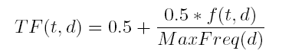
TF Weighting
Weighting:
More frequent => more relevant to topic
Raw TF= f(t,d): how many times term t appears in doc d
Normalization:
Document length varies => relative frequency preferred
e.g., Maximum frequency normalization

Slide 64
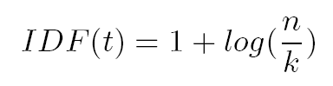
IDF Weighting
Ideas:
Less frequent among documents → more discriminative
Formula:
n — total number of docs
k — # docs with term t appearing
(the DF document frequency)

Slide 65
TF-IDF Weighting
TF-IDF weighting : weight(t, d) = TF(t, d) * IDF(t)
Freqent within doc → high tf → high weight
Selective among docs → high idf → high weight
Recall VS model
Each selected term represents one dimension
Each doc is represented by a feature vector
Its t-term coordinate of document d is the TF-IDF weight
This is more reasonable
Just for illustration …
Many complex and more effective weighting variants exist in practice

Slide 66
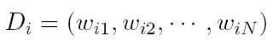
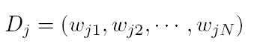
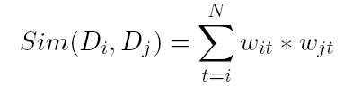
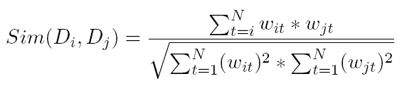
How to Measure Similarity?
Given two document
Similarity definition
dot product
normalized dot product (or cosine)

Slide 67
Illustrative Example
text
mining
search
engine
text
doc1
Sim(newdoc,doc1)=4.8*2.4+4.5*4.5
Sim(newdoc,doc2)=2.4*2.4
Sim(newdoc,doc3)=0
To whom is newdoc more similar?
travel
text
map
travel
doc2
text mining travel map search engine govern president congress
IDF(faked) 2.4 4.5 2.8 3.3 2.1 5.4 2.2 3.2 4.3
doc1 2(4.8) 1(4.5) 1(2.1) 1(5.4)
doc2 1(2.4 ) 2 (5.6) 1(3.3)
doc3 1 (2.2) 1(3.2) 1(4.3)
newdoc 1(2.4) 1(4.5)
government
president
congress
doc3
……

Slide 68
VS Model-Based Classifiers
What do we have so far?
A feature space with similarity measure
This is a classic supervised learning problem
Search for an approximation to classification hyper plane
VS model based classifiers
K-NN
Decision tree based
Neural networks
Support vector machine

Slide 69
Probabilistic Retrieval Models
The ranking function based on the probability that a given document d is relevant to a query q,
or p(R = 1| d, q) where R ∈ {0, 1} is a binary random variable denoting relevance.
In query likelihood retrieval model (one of the probabilistic models), we assume that this probability of relevance can be approximated by the probability of a query given a document and relevance,
p(q | d, R = 1).
Intuitively, if a user likes document d, how likely would the user enter query q in order to retrieve document d?

Slide 70
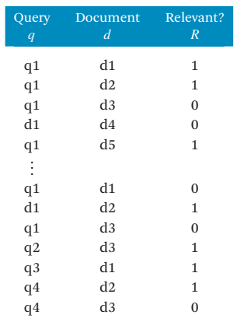
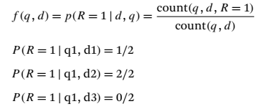
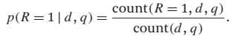
Probabilistic Retrieval Models
Clearly, p(R = 1 | d, q) + p(R = 0 | d, q) = 1

Slide 71
Summary: Text Categorization
Wide application domain
Comparable effectiveness to professionals
Manual TC is not 100% and unlikely to improve substantially.
A.T.C. is growing at a steady pace
Prospects and extensions
Very noisy text, such as text from O.C.R.
Speech transcripts

Slide 72
Types of Text Data Mining
Keyword-based association analysis
Automatic document classification
Similarity detection
Cluster documents by a common author
Cluster documents containing information from a common source
Link analysis: unusual correlation between entities
Sequence analysis: predicting a recurring event
Anomaly detection: find information that violates usual patterns
Hypertext analysis
Patterns in anchors/links
Anchor text correlations with linked objects

Slide 73
Keyword-Based Association Analysis
Motivation
Collect sets of keywords or terms that occur frequently together and then find the association or correlation relationships among them
Association Analysis Process
Preprocess the text data by parsing, stemming, removing stop words, etc.
Evoke association mining algorithms
Consider each document as a transaction
View a set of keywords in the document as a set of items in the transaction
Term level association mining
No need for human effort in tagging documents
The number of meaningless results and the execution time is greatly reduced

Slide 74
Text Classification
Motivation
Automatic classification for the large number of on-line text documents (Web pages, e-mails, corporate intranets, etc.)
Classification Process
Data preprocessing
Definition of training set and test sets
Creation of the classification model using the selected classification algorithm
Classification model validation
Classification of new/unknown text documents
Text document classification differs from the classification of relational data
Document databases are not structured according to attribute-value pairs

Slide 75
Document Clustering
Motivation
Automatically group related documents based on their contents
No predetermined training sets or taxonomies
Generate a taxonomy at runtime
Clustering Process
Data preprocessing: remove stop words, stem, feature extraction, lexical analysis, etc.
Hierarchical clustering: compute similarities applying clustering algorithms.
Model-Based clustering (Neural Network Approach): clusters are represented by “exemplars”. (e.g.: SOM)

Slide 76
Challenges in Mining WWW
The Web is too huge for effective data warehousing and data mining. It is barely possible to set up a data warehouse to replicate, store, or integrate all of the data on the Web
The complexity of Web pages is far greater than that of any traditional text document collection. There is no index by category, nor by title, author, cover page, table of contents, etc.
The Web is a highly dynamic information source. Not only does the Web grow rapidly, but is also constantly updated. Linkage information and access records are also updated frequently
The Web serves a broad diversity of user communities. Users may have very different backgrounds, interests, and usage purposes.
Only a small portion of the information on the Web is truly relevant or useful. It is said that 99% of the Web information is useless to 99% of Web users. How can the portion of the Web that is truly relevant to your interest be determined? How can we find high quality Web pages on a specified topic?
Notes:
Noise:
First, web pages usually do not contain pure content. A web page typically contains various types of materials that are not related to the topic of the web-page.
Multiple topics:
Secondly, a web page usually contains multiple topics, for example, a news page containing many different comments on a particular event or politician, or a conference web page containing sponsors from different companies and organizations. Although traditional documents also often have multiple topics, they are less diverse so that the impact on retrieval performance is smaller.
There exist some new characteristics in web pages:
Two-Dimension Logical Structure – Different from free-text documents, web pages have a 2-D view and a more sophisticated internal content structure. Each block of a web page could have relationships with blocks from up to four directions and contain or be contained in some other blocks. A content structure in semantic level exists for most pages and can be used to enhance retrieval.
Visual Layout Presentation – To facilitate browsing and attract attention, web pages usually contain much visual information in the tags and properties in HTML [20]. Typical visual hints include lines, blank areas, colors, pictures, fonts, etc. Visual cues are very helpful to detect the semantic regions in web pages.

Slide 77
Search Engine – Two Rank Functions
Ranking based on link structure analysis
Search
Rank Functions
Importance Ranking
Similarity based on content or text
(Link Analysis)
Relevance Ranking
Backward Link
Web Topology
Indexer
(Anchor Text)
Graph
Inverted
Index
Anchor Text
Web Graph
Generator
Constructor
Term Dictionary
Meta Data
Forward
Forward
URL
(Lexicon)
Index
Link
Dictioanry
Web Page Parser
Web Pages

Slide 78
Relevance Ranking
Inverted index
- A data structure for supporting text queries
- like index in a book
aalborg 3452, 11437, …..
.
.
.
.
.
arm 4, 19, 29, 98, 143, ...
armada 145, 457, 789, ...
armadillo 678, 2134, 3970, ...
armani 90, 256, 372, 511, ...
.
.
.
.
.
zz 602, 1189, 3209, ...
indexing
disks with
documents
inverted index

Slide 79
Introduction on PageRank
PageRank is a link analysis algorithm … with the purpose of "measuring" its (Webpage) relative importance within the set.
– From Wikipedia, the free encyclopedia
Developed by Larry Page as his PhD research topic
3 years later, he quit Stanford and founded Google with Brin
Apparently Larry Page had lost his PhD qualification.

Slide 80
PageRank: the intuitive idea
PageRank relies on the democratic nature of the Web by using its vast link structure as an indicator of an individual page's value or quality.
PageRank interprets a hyperlink from page x to page y as a vote, by page x, for page y.
However, PageRank looks at more than the sheer number of votes; it also analyzes the page that casts the vote.
Votes casted by “important” pages weigh more heavily and help to make other pages more "important."
This is exactly the idea of rank prestige in social network.

Slide 81
More specifically …
A hyperlink from a page to another page is an implicit conveyance of authority to the target page.
The more in-links that a page i receives, the more prestige the page i has.
Pages that point to page i also have their own prestige scores.
A page of a higher prestige pointing to i is more important than a page of a lower prestige pointing to i.
In other words, a page is important if it is pointed to by other important pages.

Slide 82
PageRank algorithm
According to rank prestige, the importance of page i (i’s PageRank score) is the sum of the PageRank scores of all pages that point to i.
Since a page may point to many other pages, its prestige score should be shared.
The Web as a directed graph G = (V, E). Let the total number of pages be n. The PageRank score of the page i (denoted by P(i)) is defined by:
O_{j} is the number of out-link of j

Slide 83
Matrix notation
We have a system of n linear equations with n unknowns. We can use a matrix to represent them.
Let P be a n-dimensional column vector of PageRank values, i.e., P = (P(1), P(2), …, P(n))^{T}.
Let A be the adjacency matrix of our graph with
We can write the n equations with (PageRank)

Slide 84
Calculation of PageRank on Webpage
A
B
C
D
R(.) = PageRank of a Webpage
R(A) = 100%R(B) + 50%R(C)
R(B) = 50%R(C) + 100%R(D)
R(C) = 100%R(A)

Slide 85
HITS
HITS stands for Hypertext Induced Topic Search. (developed by Jon Kleinberg in 1998 – used by Ask.com)
Unlike PageRank which is a static ranking algorithm, HITS is search query dependent.
When the user issues a search query,
HITS first expands the list of relevant pages returned by a search engine and
then produces two rankings of the expanded set of pages, authority ranking and hub ranking.
Authority: Roughly, a authority is a page with many in-links.
The idea is that the page may have good or authoritative content on some topic and
thus many people trust it and link to it.
Hub: A hub is a page with many out-links.
The page serves as an organizer of the information on a particular topic and
points to many good authority pages on the topic.

Slide 86
The HITS algorithm: Grab pages
Given a broad search query, q, HITS collects a set of pages as follows:
It sends the query q to a search engine.
It then collects t (t = 200 is used in the HITS paper) highest ranked pages. This set is called the root set W.
It then grows W by including any page pointed to by a page in W and any page that points to a page in W. This gives a larger set S, base set.

Slide 87
The link graph G
HITS works on the pages in S, and assigns every page in S an authority score and a hub score.
Let the number of pages in S be n.
We again use G = (V, E) to denote the hyperlink graph of S.
We use L to denote the adjacency matrix of the graph.

Slide 88
The HITS algorithm
Let the authority score of the page i be a(i), and the hub score of page i be h(i).
The mutual reinforcing relationship of the two scores is represented as follows:

Slide 89
Strengths and weaknesses of HITS
Strength: its ability to rank pages according to the query topic, which may be able to provide more relevant authority and hub pages.
Weaknesses:
It is easily spammed. It is in fact quite easy to influence HITS since adding out-links in one’s own page is so easy.
Topic drift. Many pages in the expanded set may not be on topic.
Inefficiency at query time: The query time evaluation is slow. Collecting the root set, expanding it and performing eigenvector computation are all expensive operations

Slide 90
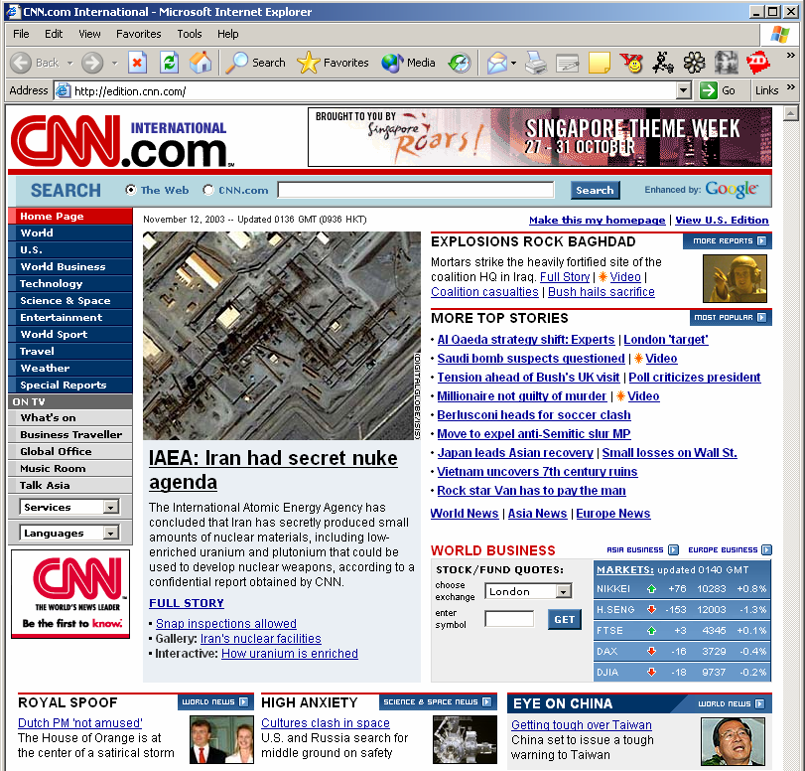
Layout Structure
Compared to plain text, a web page is a 2D presentation
Rich visual effects created by different term types, formats, separators, blank areas, colors, pictures, etc
Different parts of a page are not equally important
Title: CNN.com International
H1: IAEA: Iran had secret nuke agenda
H3: EXPLOSIONS ROCK BAGHDAD
…
TEXT BODY (with position and font type): The International Atomic Energy Agency has concluded that Iran has secretly produced small amounts of nuclear materials including low enriched uranium and plutonium that could be used to develop nuclear weapons according to a confidential report obtained by CNN…
Hyperlink:
URL: http://www.cnn.com/...
Anchor Text: AI oaeda…
Image:
URL: http://www.cnn.com/image/...
Alt & Caption: Iran nuclear …
Anchor Text: CNN Homepage News …

Slide 91
Web Page Block—Better Information Unit
Web Page Blocks
Importance = Low
Importance = Med
Importance = High

Slide 92
VIPS (VIsion-based Page Segmentation) proposed at UIUC
OVERCOMES Problems of treating a web page as an atomic unit
Web page usually contains not only pure content
Noise: navigation, decoration, interaction, …
Multiple topics
Different parts of a page are not equally important
Web page has internal structure
Two-dimension logical structure & Visual layout presentation
> Free text document
< Structured document
Layout – the 3rd dimension of Web page
1st dimension: content
2nd dimension: hyperlink
Notes:
Noise:
First, web pages usually do not contain pure content. A web page typically contains various types of materials that are not related to the topic of the web-page.
Multiple topics:
Secondly, a web page usually contains multiple topics, for example, a news page containing many different comments on a particular event or politician, or a conference web page containing sponsors from different companies and organizations. Although traditional documents also often have multiple topics, they are less diverse so that the impact on retrieval performance is smaller.
There exist some new characteristics in web pages:
Two-Dimension Logical Structure – Different from free-text documents, web pages have a 2-D view and a more sophisticated internal content structure. Each block of a web page could have relationships with blocks from up to four directions and contain or be contained in some other blocks. A content structure in semantic level exists for most pages and can be used to enhance retrieval.
Visual Layout Presentation – To facilitate browsing and attract attention, web pages usually contain much visual information in the tags and properties in HTML [20]. Typical visual hints include lines, blank areas, colors, pictures, fonts, etc. Visual cues are very helpful to detect the semantic regions in web pages.

Slide 93
VIPS
Index block instead of whole page
Block retrieval
Combing DocRank and BlockRank
Block query expansion
Select expansion term from relevant blocks
More improvement on web search can be made by mining webpage Layout structure
Leverage visual cues for web information analysis & information extraction

Slide 94
Thank You

